Slide 1
Gov 1780: International Political Economy
Section 7
11 Mar 2021

Slide 2
Agenda
Today we are going to review some of the fundamentals of trade theory. These concepts are already somewhat familiar to you, but they are SUPER important.
So think of today’s session as an opportunity to clear up any points of confusion and get to the level where you could confidently explain these concepts to someone else!
All together:
The logic of comparative advantage
Breakout rooms:
Heckscher-Ohlin
Stolper-Samuelson
Ricardo-Viner

Slide 3
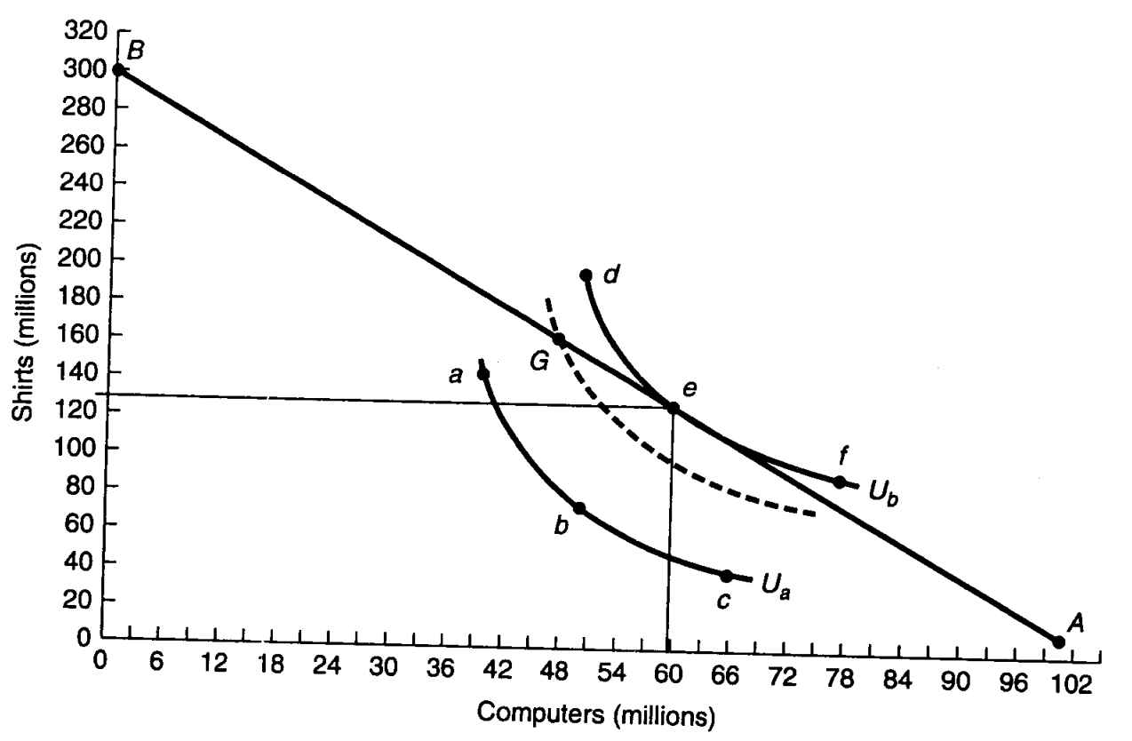
Comparative advantage
Let’s review this diagram from Oatley (p.49)

Slide 4
Comparative advantage
Let’s review this diagram from Oatley (p.49)
What does the straight line represent?

Slide 5
Comparative advantage
Let’s review this diagram from Oatley (p.49)
What does the straight line represent?
The Production Possibility Frontier (PPF)

Slide 6
Comparative advantage
Let’s review this diagram from Oatley (p.49)
What assumption are we making by drawing the PPF as a straight line?

Slide 7
Comparative advantage
Let’s review this diagram from Oatley (p.49)
What assumption are we making by drawing the PPF as a straight line?
Constant opportunity costs / Constant returns to scale in production

Slide 8
Comparative advantage
Let’s review this diagram from Oatley (p.49)
What are the curved lines?

Slide 9
Comparative advantage
Let’s review this diagram from Oatley (p.49)
What are the curved lines?
Consumption indifference curves

Slide 10
Comparative advantage
Let’s review this diagram from Oatley (p.49)
What are the curved lines?
Consumption indifference curves
Rank the consumer’s preferences over {a, b, c, d, e, f, G}

Slide 11
Comparative advantage
Let’s review this diagram from Oatley (p.49)
What are the curved lines?
Consumption indifference curves
Rank the consumer’s preferences over {a, b, c, d, e, f, G}
{d, e, f} > {G} > {a, b, c}

Slide 12
Comparative advantage
Let’s review this diagram from Oatley (p.49)
Why are the indifference curves curved rather than straight?

Slide 13
Comparative advantage
Let’s review this diagram from Oatley (p.49)
Why are the indifference curves curved rather than straight?
Diminishing marginal returns.
For the consumer, the 1st computer (or shirt) is worth more than the 10th!

Slide 14
Comparative advantage
Let’s review this diagram from Oatley (p.49)
By shifting out the indifference curve until it is at a tangent to the PPF, we arrive at point e.
Explain why e represents an equilibrium.

Slide 15
Comparative advantage
Let’s review this diagram from Oatley (p.49)
By shifting out the indifference curve until it is at a tangent to the PPF, we arrive at point e.
Explain why e represents an equilibrium.
It is the point along the PPF that maximizes consumer utility.

Slide 16
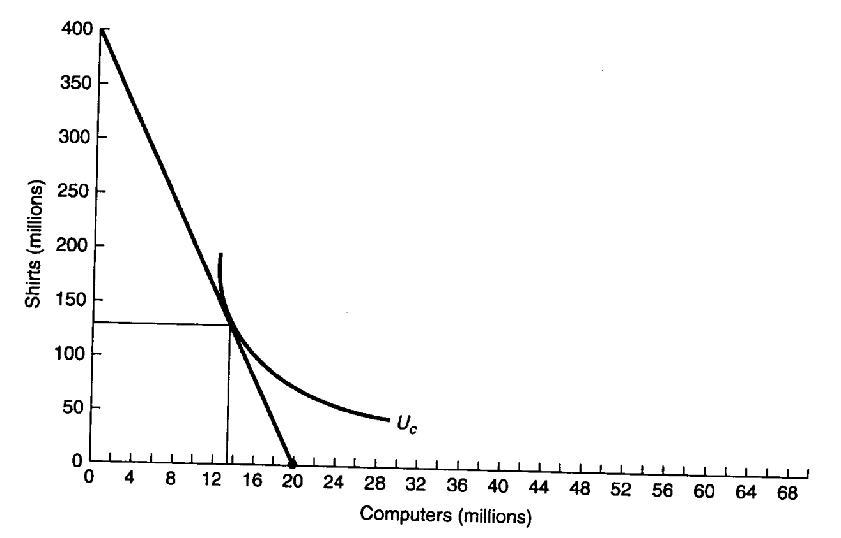
Comparative advantage
USA
Why is the slope of the PPF steeper in China vs the US?
China

Slide 17
Comparative advantage
USA
Why is the slope of the PPF steeper in China vs the US?
Look at where the PPF hits the axes. These points represent how many shirts/computers the country could product if it allocated all factors to producing that good.
China

Slide 18
Comparative advantage
USA
Why is the slope of the PPF steeper in China vs the US?
Look at where the PPF hits the axes. These points represent how many shirts/computers the country could product if it allocated all factors to producing that good.
The US can produce a maximum of 300m shirts and 102m computers.
China can produce a maximum of 350m shirts and 20m computers.
China

Slide 19
Comparative advantage
USA
OK so… does China have an absolute advantage or a comparative advantage in making shirts?
China

Slide 20
Comparative advantage
USA
OK so… does China have an absolute advantage or a comparative advantage in making shirts?
Answer: both!
China

Slide 21
Comparative advantage
USA
OK so… does China have an absolute advantage or a comparative advantage in making shirts?
Answer: both!
China has an absolute advantage in shirts because using all available resources it can produce more than the US (350m > 300m).
China also has a comparative advantage in shirts because it face lower opportunity costs (= the computers that could have been made).
China

Slide 22
Comparative advantage
USA
So far the diagrams assume that each country is autarkic.
What happens if the two countries can trade with each other?
China

Slide 23
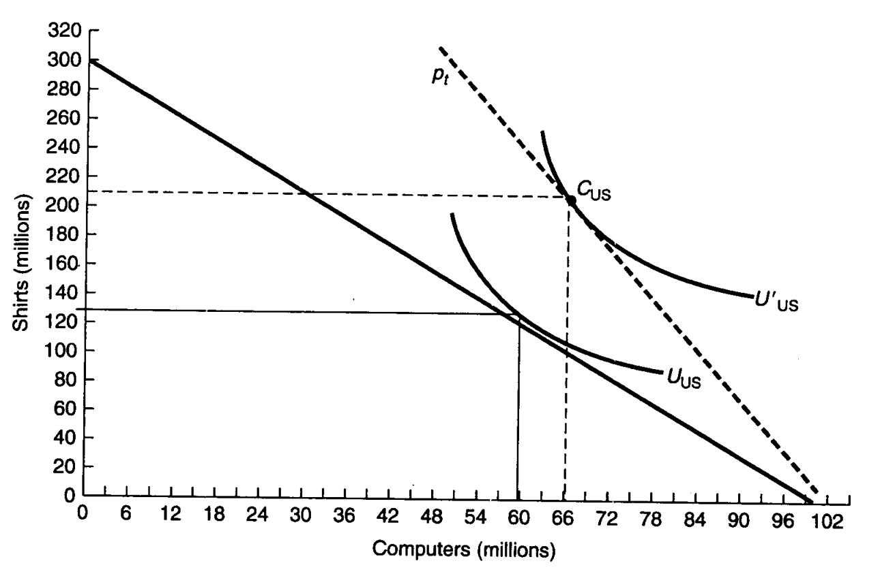
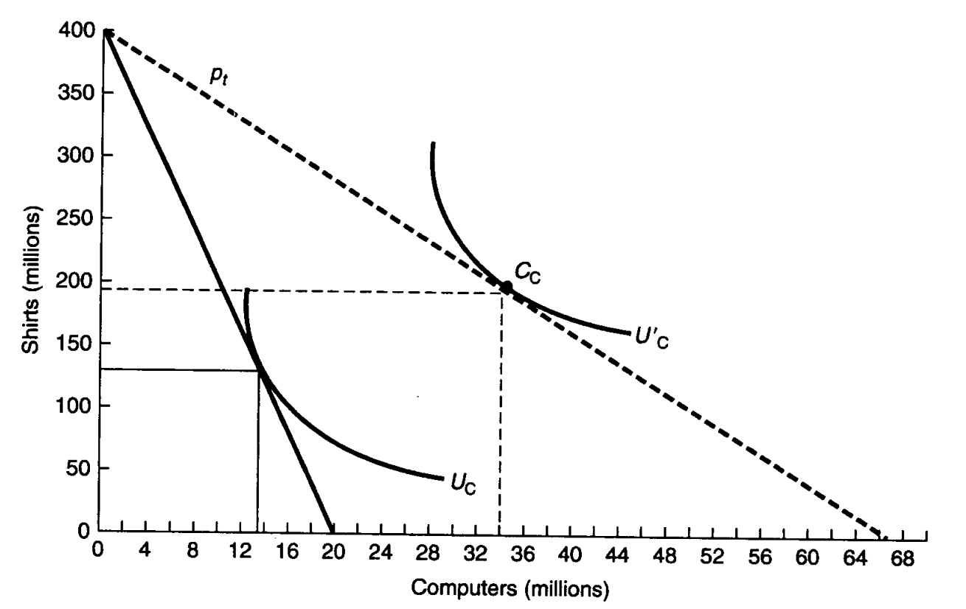
Comparative advantage
USA
So far the diagrams assume that each country is autarkic.
What happens if the two countries can trade with each other?
USA specializes in producing computers
China specializes in producing shirts
China

Slide 24
Comparative advantage
USA
What does the dotted line represent?
China

Slide 25
Comparative advantage
USA
In autarky, one computer costs 3 shirts in the US, but costs 20 shirts in China.
Under free trade, the countries trade at a price somewhere between those two rates. Let’s assume: 6 shirts per computer.
China

Slide 26
Comparative advantage
USA
In autarky, one computer costs 3 shirts in the US, but costs 20 shirts in China.
Under free trade, the countries trade at a price somewhere between those two rates. Let’s assume: 6 shirts per computer.
For the US, one computer can now “buy” 6 shirts from China, instead of just 3 shirts in the US.
For China, one computer costs 6 shirts to buy from the US, as opposed to 20 shirts to produce domestically.
China

Slide 27
Comparative advantage
USA
What does this mean for consumers?
China

Slide 28
Comparative advantage
USA
What does this mean for consumers?
More consumption of both goods = higher utility!
China

Slide 29
Breakout room activity
Explain the assumptions and results of these models of trade:
Heckscher-Ohlin Model
Stolper-Samuelson Theorem
Ricardo-Viner Model (aka “Specific factors model”)
Imagine that you are an intrepid team of empirically-inclined economists:
Come up with a research design that would allow you to test which model of trade applies in a particular real-world context.
List specific hypotheses (e.g., if Heckscher-Ohlin applies, we would expect to see X, but if Ricardo-Viner applies, we would expect to see Y…)

Slide 30
Group 1

Slide 31
Group 2

Slide 32
Group 3

